Slide 1
Code Generation for Parallel Execution of a Class of Irregular Loops on Distributed Memory Systems
Mahesh Ravishankar¹, John Eisenlohr¹,
Louis-Noël Pouchet^{1,3}, J. Ramanujam²,
Atanas Rountev¹, P. Sadayappan¹
¹Dept. of Computer Science & Engineering
The Ohio State University
²School of EECS and Ctr. Comp. & Tech
Louisiana State University
³ Computer Science Department
University of California, Los Angeles

Slide 2
Motivation
Converting sequential code to distributed memory code is challenging
Create parallel data structures
Manage communication
Difficult to debug
Let the compiler do the heavy-lifting
Efficient code for affine computations
Many applications are “non-affine”
Use a combination of static and run-time analysis
Notes:
Affine computations can be done statically

Slide 3
Irregular Computation : SpMV
y
A
x
for(i = 0; i < N ; i++)
for( j = 0; j < N; j++)
y[i] += A[i][j] * x[j]
=
*
0 | 1 | 2 | 3 | 4 | 5 | 6 | 7 | 8 | 9 | 10 | 11 | 12 | 13
A =
for( i = 0 ; i < N ; i++)
for( j = row[i];
j < row[i+1] ; j++)
y[i] += A[j] * x[col[j]]
row =
0 | 2 | 5 | 7 | 9 | 12 | 14
col =
0 | 1 | 0 | 2 | 3 | 1 | 2 | 0 | 3 | 1 | 2 | 4 | 2 | 5
Notes:
Add index numbers and reverse arrows

Slide 4
Irregular Computations
for( i = 0 ; i < N ; i++)
for( j = row[i]; j < row[i+1] ; j++)
y[i] += A[j] * x[col[j]]
Data dependent control flow
Data dependent array access pattern
Multiple levels of indirection
Target loops that are parallel
Allows dependences due to commutative and associative reduction operations
Allow sparse reductions, e.g. : y[b[i]] +=
Indirection Arrays :
row and col
Partitionable loops:
loop i

Slide 5
Generating distributed memory code
Combined static/dynamic analysis
Static analysis for checking parallelism
Generate code which performs the run-time analysis, i.e. inspector code
Executor code performs the computation
For efficient distributed memory execution
Inspector has to be parallel
Avoid complete replication of any data structure
Executor must preserve properties of original code that improve per node performance
Notes:
Rethink the presentation style for this – Sell the technique more here

Slide 6
Parallelization Strategy
Disjoint partitioning of iterations of partitionable loops
no. of partitions = no. of processes
Partition the data
Local arrays represent all original elements touched by iterations mapped to a process
Create auxiliary arrays on each process to recreate the control flow and data access pattern
This functionality is provided by the inspector

Slide 7
Auxiliary Arrays : Recreating the data access patterns
i = | 0 | 1 | 2 | 3 | 4 | 5
A =
Process 0 : i = 0, 1, 2
Process 1 : i = 3, 4, 5
A_local =
A_local =
loop_j = 0;
body_j = 0;
for( i = …… ){
lb[loop_j] = row[i];
ub[loop_j] = row[i+1];
for( j = row[i] ; j < row[i+1] ; j++ ){
A_index[body_j] = j; //record index of A
body_j++;
}
loop_j++;
}
Remember loop bounds of inner loops
Remember indices of arrays accessed
Modify these to point to local memory location

Slide 8
Ghost Cells
i = | 0 | 1 | 2 | 3 | 4 | 5
col =
0 | 1 | 0 | 2 | 3 | 1 | 2 | 0 | 3 | 1 | 2 | 4 | 2 | 5
Process 0 : i = 0, 1, 2
Process 1 : i = 3, 4, 5
0 | 1 | 0 | 2 | 3 | 1 | 2
0 | 3 | 1 | 2 | 4 | 2 | 5
x_local =
x[0] | x[1] | x[2] | x[3]
x_local=
x[0] | x[1] | x[2] | x[3] | x[4] | x[5]
Same element might be touched by iterations on multiple processes
Every element has a unique owner
On other processes, treat them as ghost elements
Notes:
Show homed in block boxes and ghosts in dotted

Slide 9
Ghost Cells
Ghosts cells within read arrays updated before loop is executed
Ghosts cells within updated arrays
Initialized to 0 at the start of the loop
Contain partial contributions after loop execution
Communicated to owner for aggregation
Enable execution of all iterations without communication
Number of ghosts cells represents the amount of communication

Slide 10
Reducing the number of ghost cells
i = | 0 | 1 | 2 | 3 | 4 | 5
col =
0 | 1 | 0 | 2 | 3 | 1 | 2 | 0 | 3 | 1 | 2 | 4 | 2 | 5
Process 0 : i = 0, 1, 3
Process 1 : i = 1, 2, 4
0 | 1 | 0 | 2 | 3 | 0 | 3
1 | 2 | 1 | 2 | 4 | 2 | 5
x[0] | x[1] | x[2] | x[3]
x[1] | x[2] | x[4] | x[5]
Partitioning based on iteration-to-data affinity
Fewer ghosts => Less Communication
Iteration-to-data affinity is represented by a hypergraph
Notes:
Same as before….

Slide 11
Hypergraph Representation
Hypergraph, H = ( V,E )
Vertex v represents an iteration of the partitionable loop
Hyper-edge e represents a data element of the computation
Hyper-edge connects all vertices that touch the same data element
Constrained partitioning the hypergraph => Efficient partitioning the computation
Load balance the iterations
Reduce the number of edges cut => reduction in ghost elements

Slide 12
Exploiting Contiguous Accesses
Elements of A accessed in contiguous manner
Local arrangement preserves contiguity
Store only first element of each sequence
Remaining elements obtained by an offset
 | 1 | 2 |  | 4
A =
On Process 1 : i = 1, 2, 4
A_local =
A_start[0]
+ offset
A_start =
0 | 2 | 5

Slide 13
Exploiting Contiguous Accesses
What is the use of contiguity
Smaller auxiliary arrays => Smaller footprint
Helps with optimizations like prefetching, etc.
Static analysis can reveal which expressions result in contiguous accesses
Elements accessed through such expressions remembered by the inspector
Arranged in ascending order of original index
Maintains contiguity even in partially overlapping sequences
A[1] | A[2]
A[1] | A[2] | A[3] | A[4]
A[2] | A[3] | A[4]

Slide 14
Parallel Inspector
Inspector work-flow
In parallel without complete replication of any of the original arrays
Phase I – Analyze a block of iterations on each process
Phases II & III – Analyze the iterations mapped to a process
Challenge : Indirection Arrays are partitioned too
Build and partition the hypergraph
Compute sizes of auxiliary arrays
Populate and renumber values
Notes:
Highlight phases

Slide 15
Parallel Inspector
Process 1: i = 3, 4, 5
Flagged Elements
Fetch Elements
i = | 3 | 4 | 5
row[3]
row[3]
i = | 3 | 4 | 5
i = | 3 | 4 | 5
i = | 3 | 4 | 5
is row[3] known ? false
is row[4] known ? true
is row[4] known ? true
is row[5] known ? true
is row[6] known ? true
is row[7] known ? true
is row[3] known ? true
is row[4] known ? true
for (j = row[ i ] ; j < row [ i + 1] ; j++)
For every iteration of i
check if accessed values of row are known on a process
if not, flag the element as requested
skip statements that need this value
Analyze all iterations before retrieving flagged values
re-analyze the iterations
Multiple sweeps might be needed to retrieve all unknown values

Slide 16
Related Work
Joel Saltz group
CHOAS libraries : one-level of indirection
Compiler framework : Could not handle all sparse reductions
Basumallik and Eigenmann (PPoPP 06)
Requires replication of shared data – higher foot-print
LaMielle and Strout (CSU TR ’10, LCPC ‘12)
Sparse Polyhedral Framework
A more general approach, additional constraints needed to exploit contiguity, etc.
more discussed in the paper

Slide 17
Benchmarks
Evaluation of approach
Benchmarks : 183.equake from SPEC 2000, Conjugate Gradient Kernel, etc.
Production Application – Ocean, Land and Atmosphere Modeling (OLAM)
Compared against manual MPI implementations
Contain a sequence of partitionable loops
Inspectors of all loops were merged
Enclosed within an outer sequential loop
Inspector hoisted out for amortizing costs

Slide 18
Experimental Setup
Code generation algorithm implemented within the ROSE compiler framework
Partitioners
PaToH – Sequential hypergraph partitioner
ParMetis – Parallel Graph Partitioner
Convert the hypergraph to equivalent graph
Cluster with Intel Xeon E5460 processor – 4 cores per node
Communication implemented using ARMCI one sided communication operations, GA – 5.1
Notes:
Change reason for block-partitioner usage

Slide 19
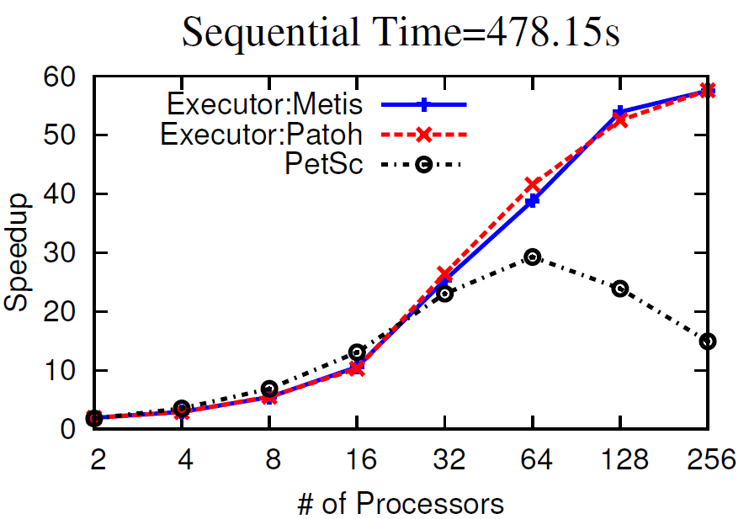
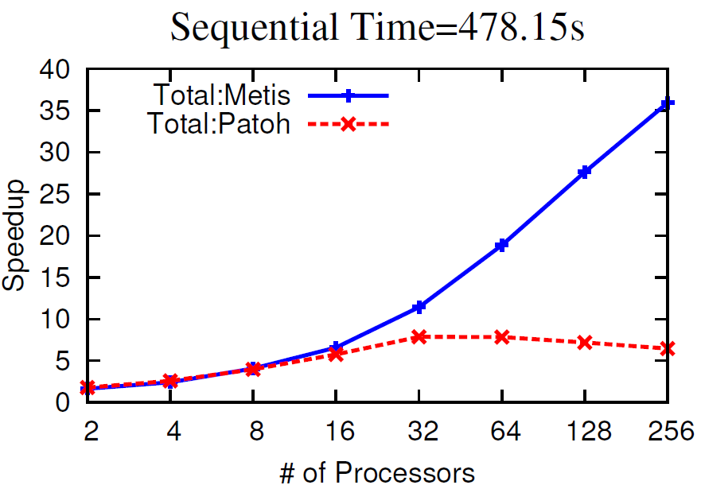
CG Kernel – hood.rb
Sparse Matrix : 220,542 rows; 9,895,422 non-zeros
Lowest Execution Times : PaToH and ParMetis
478.15s => 8.3s , with inspector costs => 13.31s
PetSc implementation : CG solver , no pre-conditioning
Arrays rows block-partitioned across the solver
Notes:
Make mode of PetSc more clear. Get rid of block-partitioning

Slide 20
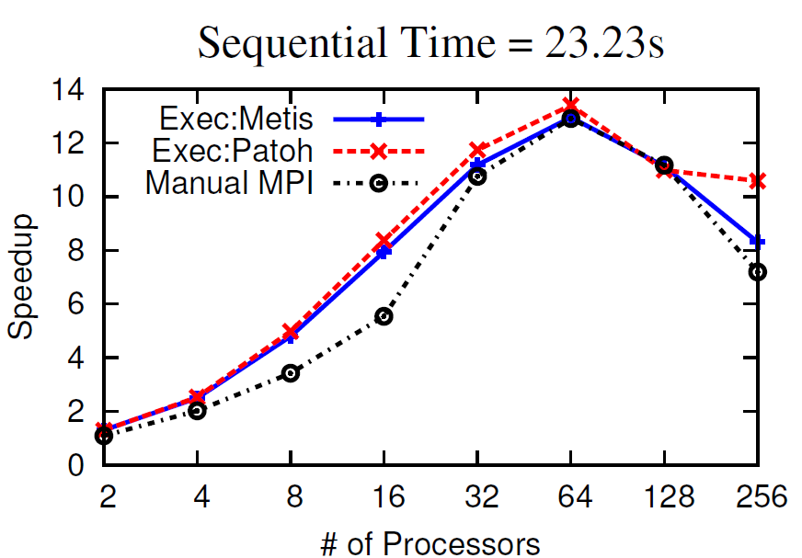
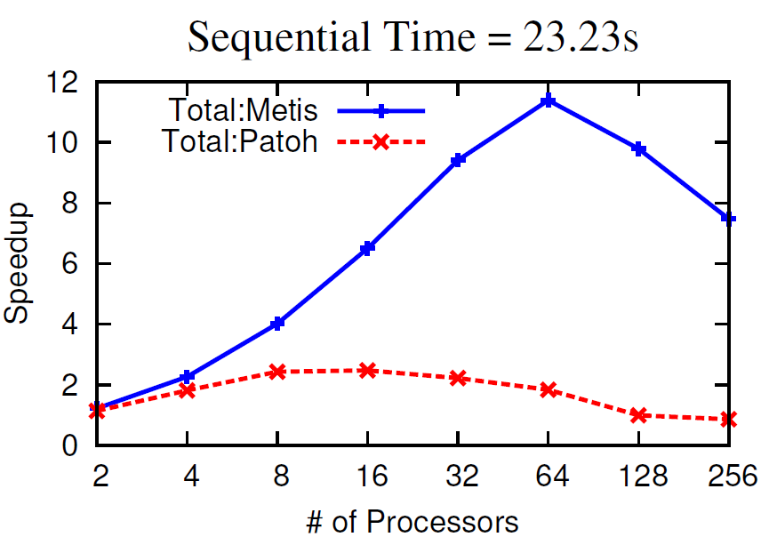
183.equake
Unstructured grid : Tetrahedral elements
Performance comparable to manual implementation
Minimum Execution time : 23.23s => 2.1s
Negligible inspector times with ParMetis
At 64 processes, 0.23s

Slide 21
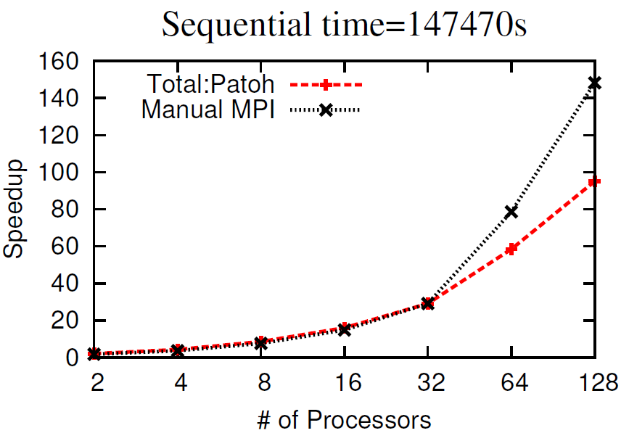
OLAM
FORTRAN 90 application
complex and inter-procedural
Outer time loop executes hundreds of thousands of iterations
Here only 30000 time steps
Generated code scales linearly
manual version scales super-linearly due to smaller footprint attained due to domain specific knowledge
Notes:
Change the tone of argument for generated code

Slide 22
Conclusion
Framework to automatically generate distributed memory code
Partitioning the computation based on iteration-to-data affinity
Parallel inspector without complete replication of any original data structures
Generated code maintains contiguity of accesses to data
Enable subsequent optimizations such as prefetching
Performance is comparable to manual MPI implementation
when inspector cost can be effectively amortized

Slide 23
Thank You
Acknowledgements
Prof. Umit Catalyurek, Prof. Gagan Agrawal, Prof. Robert Walko, and the reviewers
More detailed technical report available at www.cse.ohio-state.edu/~ravishan/
Questions?

Slide 24
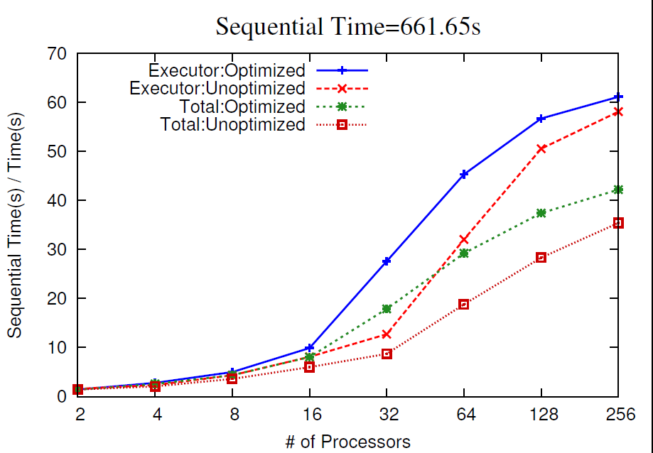
Impact of contiguity

Slide 25
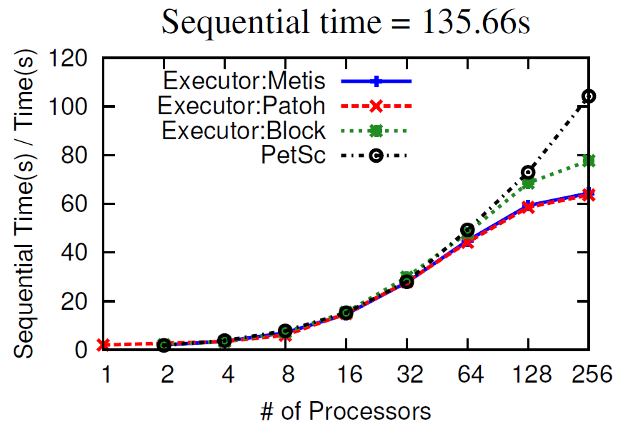
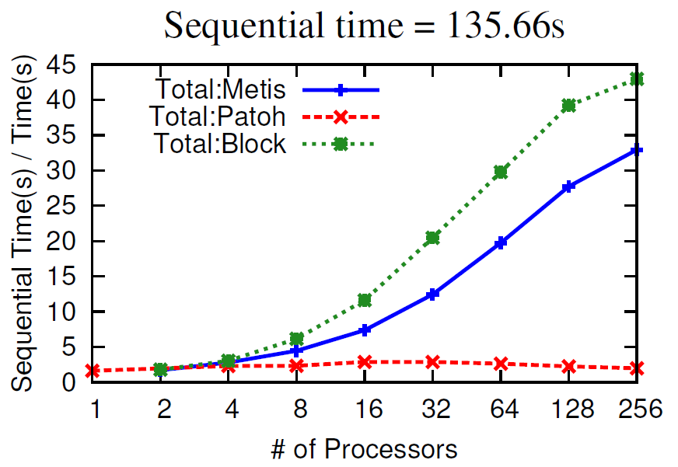
CG Kernel – tmt_sym.rb
Sparse Matrix : 726,713 rows; 5,080,961 non-zeros
All three execution times almost similar
Difference is due to structure of the two matrices

Slide 26
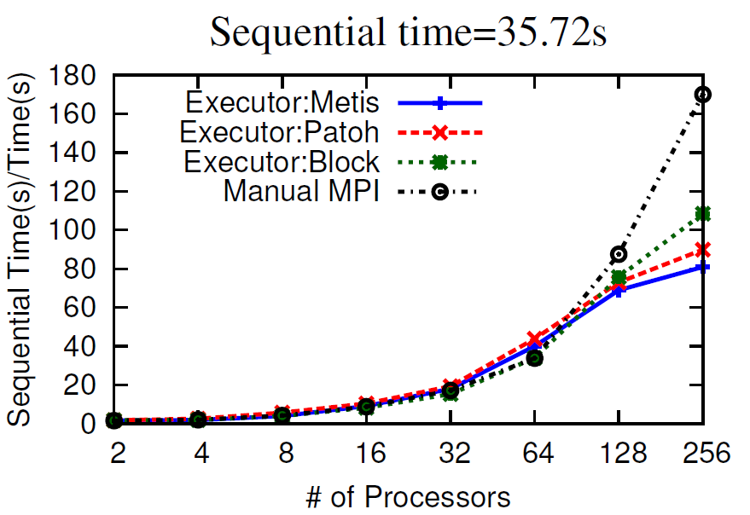
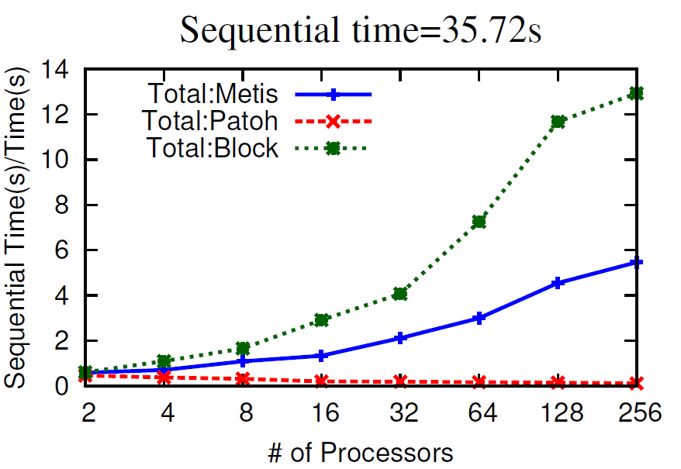
miniFE – 1.1
Unstructured 3D grid – 100 x 100 x 100 elements
Executor performance comparable to manual MPI
Relatively higher inspector costs
Actual execution time is very small for such a large grid

Slide 27
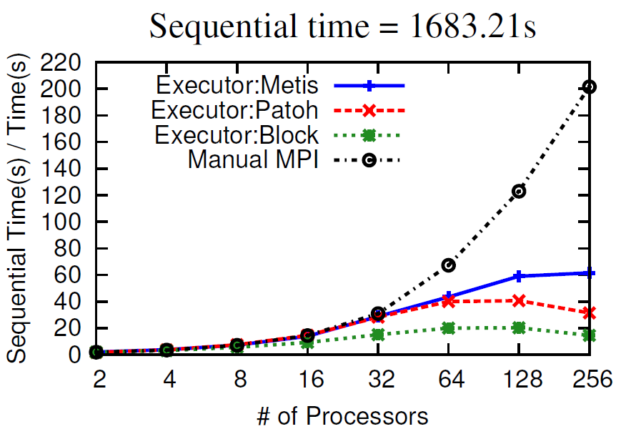
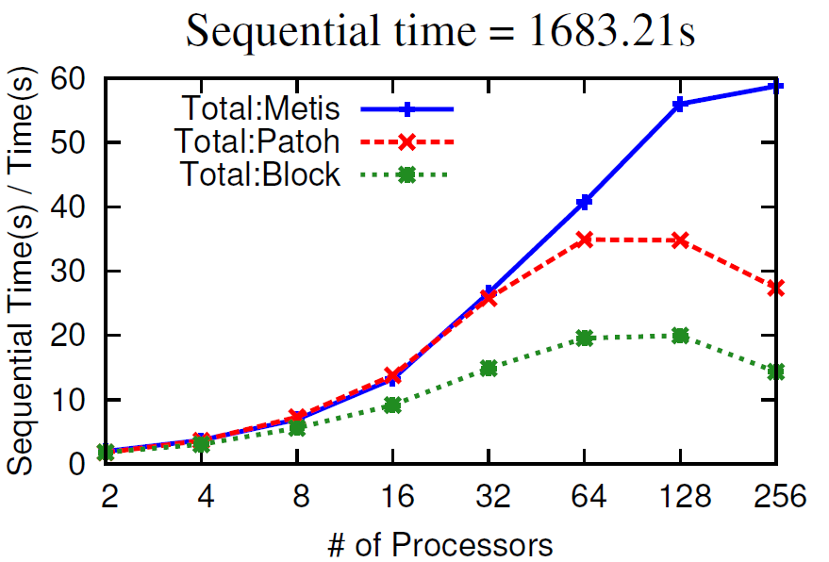
P3-RTE benchmark
Unstructured 2D grid – triangular elements
Negligible inspector times
Comparable to manual implementation upto 32 processors
Manual achieves better scaling due to replication of computation to reduce communication

