Slide 1
Speculative Region-based Memory Management for Big Data Systems
Khanh Nguyen, Lu Fang, Harry Xu, Brian Demsky
Donald Bren School of
Information and Computer Sciences

Slide 2
BIG DATA
…
Notes:
Cloudera is the first that comercialized Hadoop – claimed to be the leader – opened in 2008
Hortonworks is Hadoop-enterprise – opened in 2011
Giraph: open-source counterpart of Pregel
Hama: general Bulk Synchronous Processing computing engine on top of Hadoop to do scientific computing, iterative algorithm such Matrix, Graph and Machine Learning
Hive: data warehouse: query and manage large datasets in distributed storage using SQL-like language, based on MapReduce – initially developed by Facebook
Pig: has high-level language to express data analysis program – its infrastructure support parallel execution, auto-tune efficiency. On Hadoop
Storm: distributed realtime computation system, easy to process unbounded streams of data. Utilize queueing and database technologies to consume data in arbitrary complex way, repartition streams between each stage
Flume: library for collecting, aggregating and moving large amounts of log data. Main goal is to deliver data from applications to HDFS, based on streaming data flow.
Mahout: machine learning, dumped Hadoop, used Spark

Slide 3
BIG DATA
Scalability
JVM crashes
due to OutOfMemory error at early stage

Slide 4
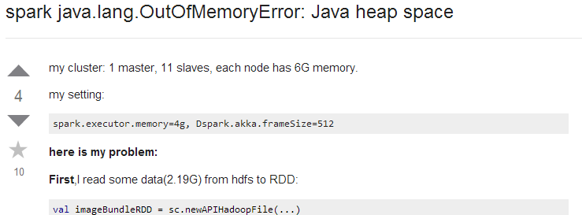
A moderate-size application on Giraph with 1GB input data can easily run out of memory on a 12 GB heap
[Bu et al, ISMM’13]

Slide 5
BIG DATA
Scalability
JVM crashes
due to OutOfMemory error at early stage
Management cost
GC time accounts for up to 50% of the execution time
[Bu et al, ISMM’13]
High cost of the managed runtime is a fundamental problem!

Slide 6
Existing Work
Facade [Nguyen et al, ASPLOS’15]
Broom [Gog et al, HotOS’15]
Huge manual effort from developers
This work:
Purely dynamic technique

Slide 7
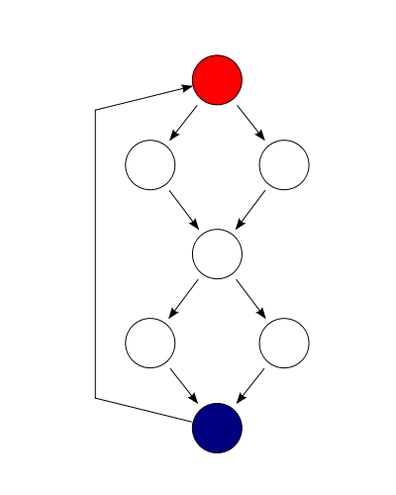
Control Path vs. Data Path
Process the actual data
Code size is small (36%)
Create most of the runtime objects (95%)
Pipeline construction
Job state management
Perform optimization
[Bu et al, ISMM’13]

Slide 8
Execution Pattern
Data-processing functions are iteration-based
Each iteration processes a distinct data partition
Iterations are well-defined

Slide 9
GraphChi [Kyora et al, OSDI’12]
public interface GraphChiProgram <VertexDataType, EdgeDataType> {
public void update(ChiVertex<VertexDataType, EdgeDataType> vertex, GraphChiContext context);
public void beginIteration(GraphChiContext ctx);
public void endIteration(GraphChiContext ctx);
public void beginInterval(GraphChiContext ctx, VertexInterval interval);
public void endInterval(GraphChiContext ctx, VertexInterval interval);
public void beginSubInterval(GraphChiContext ctx, VertexInterval interval);
public void endSubInterval(GraphChiContext ctx, VertexInterval interval);
}

Slide 10
Weak Iteration Hypothesis
Data objects do not escape iteration boundaries
GC run in the middle is wasted
Control objects do escape iteration boundaries
5%
181 MILLIONS OBJECTS
PageRank – Twitter graph
Notes:
ChiVertex: 4M ChiPointer: 171M VertexDegree: 6M

Slide 11
Region-based Memory Management
Region definition
Management:
Allocation
Deallocation

Slide 12
Advantages
Low overheads
Improved data locality
More flexible than stack allocation
No GC burden

Slide 13
Challenges
Escaping control objects
Developers are responsible for semantic correctness
static analyses?
Facade
Broom
specialized API
annotation & refactoring
Precise objects lifetime required!

Slide 14
Proposed Solution
Speculative Region Allocation
annotate iteration boundary:
- iteration_start
- iteration_end
Algorithms to guarantee program’s correctness automatically

Slide 15
Observations
nested
executed by multiple threads
Iterations
iteration_ID, thread_ID

Slide 16
Region Semi-lattice
void main() {
} //end of main
heap
JOIN OPERATOR
T,*
iteration_start
for( ) {
}
iteration_end
iteration_start
for( ) {
}
iteration_end
1,t₁
1,t₂
iteration_start
for( ) {
}
iteration_end
region
2,t₁
2,t₂
3,t₁
3,t₂
GC never touches regions

Slide 17
Speculative Region Allocation
Parent
iteration_start
Child
iteration_start
iteration_end
iteration_end

Slide 18
Components of Our Approach
Speculative region allocation
Track inter-region references
Update boundary set
Recycle regions
Boundary set promotion

Slide 19
Remember Inter-Region References: Case 1
x,t_{i}
a.f = b
y,t_{i}
a
b
b
boundary set

Slide 20
Remember Inter-Region References: Case 2
x,t_{i}
a = b.f
y,t_{j}
b
f
c
c
boundary set

Slide 21
Region Recycling Algorithm
3,t₁
T,*
1,t₁
1,t₂
2,t₁
2,t₂
3,t₁
3,t₂
JOIN( , ) =
1,t₁
2,t₁
1,t₁
boundary set

Slide 22
Region Recycling Algorithm
3,t₁
T,*
1,t₁
1,t₂
2,t₁
2,t₂
3,t₁
3,t₂
JOIN( , ) =
2,t₁
2,t₂
T,*
boundary set

Slide 23
Region Recycling Algorithm
3,t₁
T,*
1,t₁
1,t₂
2,t₁
2,t₂
3,t₁
3,t₂
boundary set

Slide 24
Handling of Intricacies
Escape via the stack
Data-race-free object relocation
Details are in the paper

Slide 25
Conclusions
Goal: Reduce user’s effort
Solution: Speculative region allocation
The cost of object promotion is considerable
Can be reduced by adaptively allocating objects: feedback-directed allocation policy
Status: In the process of implementing & evaluating in the OpenJDK

Slide 26
Thank you!

