Slide 1
Resurrector: A Tunable Object Lifetime Profiling Technique
Guoqing Xu
University of California, Irvine
OOPSLA’13 Conference Talk

Slide 2
Object Lifetime Profiling (OLP)
OLP aims to understand precisely when each object dies (i.e., becomes unreachable) during execution
A wide variety of applications, including
Performance optimization
e.g., finding reusable data structures
Memory management
e.g., finding objects for pretenuring
GC simulation
e.g., recording a memory access trace for simulating GC algorithms

Slide 3
Existing OLP Techniques
Merlin
Records each object access in an event trace
Uses a backward pass to transitively recover object death points
Hundreds of times slowdown even for small programs (e.g., 752X for DaCapo-small)
GC-based approximation
The collection of an object is treated as its death
Imprecise for many applications (e.g., all false positives in [Xu-OOPSLA’12] are due to this imprecision)

Slide 4
Explore the Middle Ground
Develop a technique that works for real-world programs
Scale to large applications with reasonably small overhead
Sufficiently precise to provide usable object lifetime information
Resurrector: a tunable object lifetime profiler
Tunable precision and overhead (< 10 X)

Slide 5
An Alloc-Site-Centric Approach
Establish an object cache for each allocation site
Aggressively cache objects upon their creation
Find a dead object from the cache and resurrect it when an allocation site is executed again
o’ = resurrect (o) => death (o) ∧ creation (o’)

Slide 6
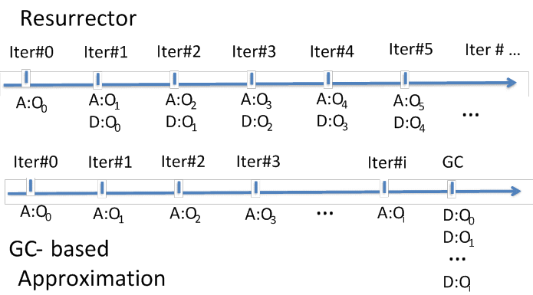
Example
for (int i = 0; i < N; i++) { O o = newObj(); … }
O newObj(){ return new O(); }=􀀃new􀀃O();􀀃􀀃…}

Slide 7
Technical Challenges
How to identify dead objects without GC
Heap reference counting
How to deal with stack references?
Stack reference counting?
We develop a timestamp-based algorithm
assigns an invocation count (IC) to each method m
increment m’s IC at each entry and exit of m

Slide 8
Tracking Objects
An object o is tagged with the following tracking info
heap reference count (rc)
method that captures o (m)
timestamp (ts): the IC of m
Insight: o loses all stack references when its capturing method o.m returns
Observation: method o.m has returned if o.m.IC > o.ts
Tracking info is updated when
o is created in a method
o is returned from a callee to a caller
o is loaded from the heap in a method

Slide 9
Timestamp Update Algorithm
A a = new A() in method n
o_{a}.rc = 0 o_{a}.ts = n.IC o_{a}.m = n
return a from n₁ to n₂
if( ) { o_{a}.ts = n₂.IC o_{a}.m = n₂ }
a = b.f in method n
if( ) { o_{a}.ts = n.IC o_{a}.m = n }
Is o_{a}.m lower than n₂ ?
o_{a}.m.IC > o_{a}.ts
Is o_{a}.m lower than n ?
o_{a}.m.IC > o_{a}.ts
Insight: if o is referenced by multiple method invocations on the stack, o.m only needs to record the “lowest” one
heap reference count (rc) capturing method (m) timestamp (ts)

Slide 10
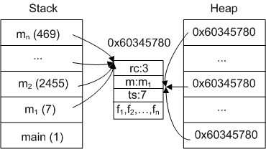
An Example
Major observations:
o is heap-unreachable if o.rc = 0
o is stack-unreachable if o.m.IC > o.ts
o is dead and resurrectable if o.rc = 0 ∧ o.m.IC > o.ts

Slide 11
New semantics of A a = new A()
for each object o in the cache list l_{a}
if o.rc = 0 ∧ o.m.IC > o.ts then
recordDeath(o)
for each object o’ referenced by o
o’.rc --
zeroOutMemory(o)
return o to the application
Allocate a new object o, add o into l_{a}, and return o

Slide 12
A Trade-off Framework
How many objects can each cache list hold?
Ideally, unbounded
the higher this number is, the more precise lifetime info can be produced
The maximum cache list length is used as a tuning parameter ml
∞: very expensive, but very precise
1: very efficient, but still more precise than the GC based approximation
All cached objects will be released if the length of a cache list exceeds ml

Slide 13
Handling of Complicated Language Features
Multi-threading
Each method has an IC vector
Each alloc site has a cache list per thread
Recursion
Each method has an additional recursion depth (RD) vector
Both IC and RD are checked to determine resurrectability
Exception handling, multi-dimentional array, object cloning, etc. are all supported

Slide 14
Evaluation
Implemented in Jikes RVM 3.1.3
Both the baseline and optimizing compilers are modified
Evaluated on the DaCapo 2006 benchmark set
Both small and large workloads
Research questions to be validated
How efficient is Resurrector?
How precise is Resurrector?
Is Resurrector useful in optimizing real-world programs?

Slide 15
Resurrector Efficiency
Algorithms
Resurrector: ml = 1, 10, 100, 200, 500, ∞
Merlin: Elephant Tracks [Ricci-ISMM’13]
GC-based approximation: Resurrector with ml = 0
Running time overhead on DaCapo-small
Merlin: 752.4 X
Resurrector: 3.2 X (1), 4.4 X (10), 3.6 X (100), 3.7 X (500), 40.2 X (∞)
GC-based approximation: 6.7 X
Overhead on DaCapo-large
Merlin: runs for very long time and generates very large traces
Resurrector : 4.9 X (1), 5.1 X (10), 5.4 X (100), 6.5 X (500), ? (∞)
GC-based approximation : 17.0 X

Slide 16

Resurrector Precision
Deallocation Difference Ratio (DDR)
Use Resurrector ml = ∞ as an approximation of Merlin
Divide an execution into a sequence s of 1MB allocation intervals
s[i] records #objects reported dead in each interval
DDR_{c} = $\frac{\text{∑}\text{|}\text{s}\text{c}\text{[}\text{i}\text{]−}\text{s}\text{∞}\text{[}\text{i}\text{]| ∗ 100}}{\text{∑}\text{s}\text{ ∞ }\text{[}\text{i}\text{] }}$

Slide 17
DDRs for Different Configurations

Slide 18
Case Studies
We have studied reports (under ml = 1) for four applications and reuse objects created by unitary alloc sites
pmd: 5.4% running time reduction, 19.6% on #objects, and 6.7% space reduction
xalan: 8.7% running time reduction, 5.5% on #objects, and 15.4% space reduction
luindex: 3.9% on #objects, and 9.9% space reduction
bloat: 5X running time reduction, 4.8% on #objects, and 3.9% space reduction
Resurrector eliminates all false positives in [Xu-OOPSLA’12]

Slide 19
Conclusions
A new OLP algorithm that explores the middle ground between high precision and high efficiency
Much more efficient than Merlin
Much more precise than the GC-based approach
Provides tunable precision and efficiency
Resurrector is publicly available at Jikes RVM Research Archive (http://jikesrvm.org/Research+Archive)

Slide 20
Thank You
Q/A

Slide 21
Example
for (int i = 0; i < N; i++) { O o = newObj(); … }
O newObj(){ return new O(); }=􀀃new􀀃O();􀀃􀀃…}
Major
insights
(1) Alloc sites are frequently executed
(2) Many dynamic techniques need alloc-site-based fine-grained lifetime information

Slide 22
GC Modification
What if the frequency of an allocation site is even lower than that of GC ?
our precision is even lower than that of the GC- based approximation
When an object o is traversed in GC, we check whether o.rc = 0 ∧ o.m.IC > o.ts holds; if this condition holds and o’s death hasn’t be recorded, we record it
This guarantees that our precision can never be lower than the GC-based approximation

Slide 23
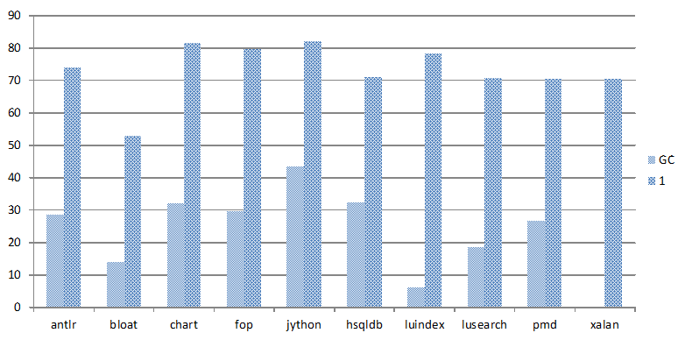
Unitary Alloc Sites Detection
Resurrector ml = 1: 72.7% alloc sites are unitary
GC-based approximation: 12.0%

