Slide 1
CoCo: Sound and Adaptive Replacement of Java Collections
Guoqing (Harry) Xu
Department of Computer Science
University of California, Irvine

Slide 2
Performance Concerns
Programming with abstractions
Modern languages exhibit clear separation between abstractions and implementations
Developers are trained to use abstractions without knowing how they are implemented
Pervasive use of large-scale, enterprise-level applications
Layers of libraries and frameworks
Inappropriate choices of implementations lead performance problems

Slide 3
Semantic Inefficiencies
Performance problems caused by developers’ inappropriate choices and mistakes
Semantics-agnostic optimizations cannot optimize them away
JIT optimizations do not help
Human insight is required
Develop semantics-aware optimizations

Slide 4
Container Inefficiencies
Inappropriate choice of containers is an important source of bloat
Examples
Use HashSet to store very few elements
ArraySet or SingletonSet
Call many get(i) on a LinkedList
ArrayList
…

Slide 5
Optimizing Containers
Container semantics required
Different design and implementation rationales
Chameleon – an offline approach [PLDI 2009]
Profile container usage
Report problematic container choices
Make recommendations
Make it online? – remove burden from developers completely
Appears to be an impossible task
Soundness – how to provide consistency guarantee
Performance – how to reduce switch overhead

Slide 6
Nothing Is Impossible
The CoCo approach
Users specify replacement rules, e.g.,
LinkedList ArrayList if #get(i) > X
CoCo switches implementations at run time
CoCo is an application-level approach that performs optimizations via pure Java code
Manually modified container code
Automatically generated glue code
Goal: reduce running time by exploiting algorithmic advantages of different implementations

Slide 7
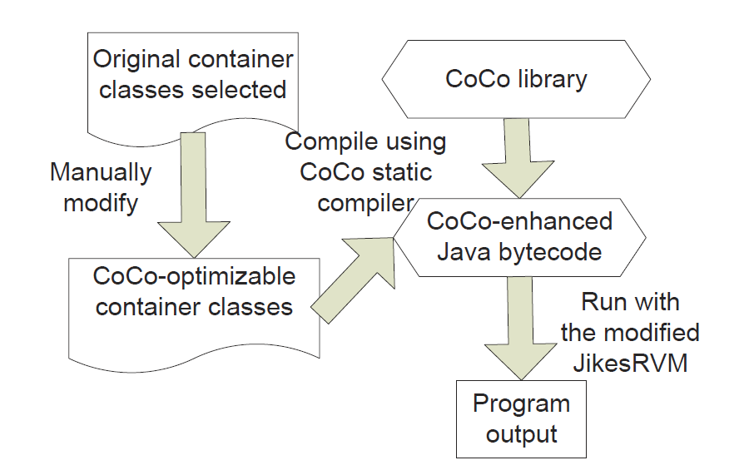
CoCo System Overview
Manually modify container classes to make them CoCo-optimizable
Use CoCo static compiler to generate glue code and compile it with the optimizable container classes
Run the program
No work is needed for end developers

Slide 8
The CoCo Methodology
CoCo works only for same-interface optimizations
LinkedList can be replaced only with another List (that implement java.util.List)
For each allocation of container type c, create a group of other containers {c₁, c₂, c₃}
LinkedList l = new LinkedList();
Container Combo
ArrayList
Hash
ArrayList
LinkedList
XYZList
Inactive
Active

Slide 9
Soundness
add(o)
Active
All operations are performed only on the active container
When an object is added into the active container, its abstraction is added into inactive containers
LinkedList
Combo
get()
ArrayList
addAbstraction(α)
Inactive
Hash
ArrayList
addAbstraction(α)
Inactive
XYZList
addAbstraction(α)
Inactive

Slide 10
Soundness
active
Once a switch rule evaluates to true, an inactive container becomes active
If an abstraction is located by a retrieval, it is concretized to provide safety guarantee
LinkedList
Combo
o
get()
α
o
concretize
ArrayList
α
Inactive
Hash
ArrayList
α
Inactive
XYZList
α
Inactive
if #get(i) > X
LinkedList ArrayList

Slide 11
Optimizable Container Classes
Manually modified
Automatically generated
class LinkedList implements List {
void add (Object o) { //actual stuff }
Object get (int index) {//actual stuff }
}
ListCombo combo = … ;
class ListCombo implements List {
void add(Object o) {
}
Object get(int index) {
}
}
}
$CoCo
void add (Object o) {combo.add(o);}
List active = …;
List[] inactiveList = …;
$CoCo
Object get (int index) { return combo.get(index);}
active.add$CoCo(o);
for each l in inactiveList {
l.addAbstract(α);
}
class ArrayList implements List {
void add (Object o) { //actual stuff }
Object get (int index) { //actual stuff }
}
ListCombo combo = … ;
$CoCo
void add (Object o) {combo.add(o);}
Object o = active.get$CoCo(index);
If (o instanceof Abstraction) {
o = active.concretize(o, index);
} return o;
$CoCo
Object get (int index) { return combo.get(index);}

Slide 12
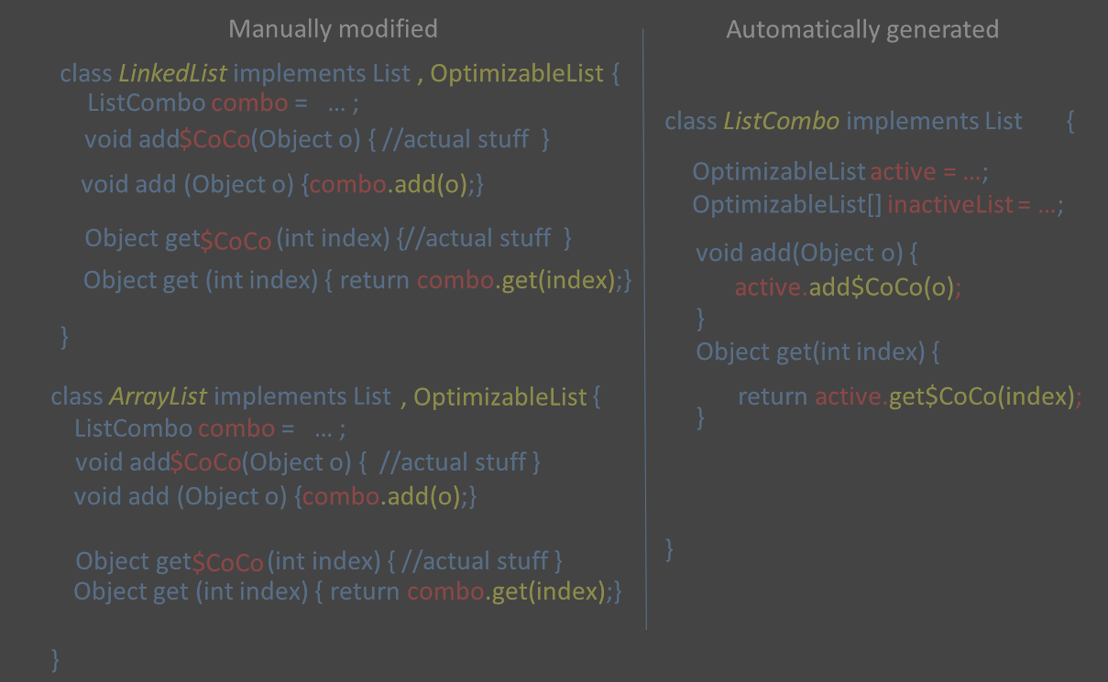
Optimizable Container Classes
LinkedList l = new LinkedList();
l.add(o);
create combo
call
create inactive lists
forward
dispatch

Slide 13
Perform Online Container Switch
class ListCombo implements List {
void add(Object o) {
}
Object get(int index) {
}
}
Change field active to the appropriate container
The client still interfaces with the original container
profileAndReplace(ADD);
active.add$CoCo(o); …
profileAndReplace(GET);
Object o = active.get$CoCo(index); …
void profileAndReplace(int oprType) {
switch(oprType) { //profiling
case ADD: ADD_OPR++; break;
case GET: GET_OPR++; break;
}
//rules
if (GET_OPR > X && active instanceof LinkedList)
swap(active, inactive[i]); // inactive[i] is ArrayList
}

Slide 14
Abstraction
An abstraction is a placeholder for a set of concrete elements
Container specific
Its granularity influences performance
Two simple ways to define abstractions
Most fine-grained: One abstraction for each element
Most coarse-grained: One abstraction for all elements

Slide 15
Our Abstractions
We have modified 4 containers from the Java Collections Framework and implemented 3 from the scratch
List – ArrayList, LinkedList, and HashArrayList Map – HashMap and ArrayMap Set – HashSet and ArraySet
The same set of switch rules as used in Chameleon
For List, an abstraction contains
Host container ID
Indices of a range of elements it represents

Slide 16
Abstraction and Concretization Functions
List
Update existing abstractions or create a new abstraction upon an add
Concretization first splits an retrieved abstraction and brings back exactly one element requested by the client
For Map and Set, one single abstraction is used to represent all concrete elements

Slide 17
Implementation
Modify Jikes RVM to do the instrumentation
Replace each new java.util.X (…) with new coco.util.X (…) in both the baseline and the optimizing compiler
Optimizations
Dropping combo
Sampling
Lazy creation of inactive containers
Aggressively inline CoCo-related methods

Slide 18
Evaluation
Micro-benchmarks
75X faster for one benchmark after switching from ArrayList to HashArrayList
Five large-scale (DaCapo) applications
bloat, chart, fop, lusearch, and avrora
1/50 sampling rate : profileAndReplace is invoked once per 50 calls to add/get
14.6% speedup on average at the cost of 18.8% space overhead

Slide 19
Conclusions
A semantics-aware bloat removal technique
Developer insight is encoded by
Replacement rules
Abstraction and concretization functions
Future dynamic optimization research
Develop more semantics-aware optimization techniques

Slide 20
Thanks You
Q/A

Slide 21
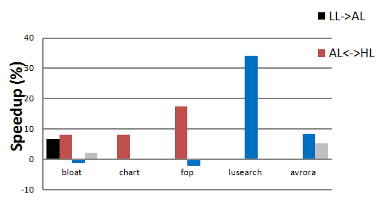
Optimizations Do HelpO

