Slide 1
Graspan: A Single-Machine Disk-based Graph System for Inter-proecedural Static Analysis
Kai Wang, Aftab Hussain, Zhiqiang Zuo, Harry Xu, Ardalan Amiri Sani
University of California, Irvine

Slide 2
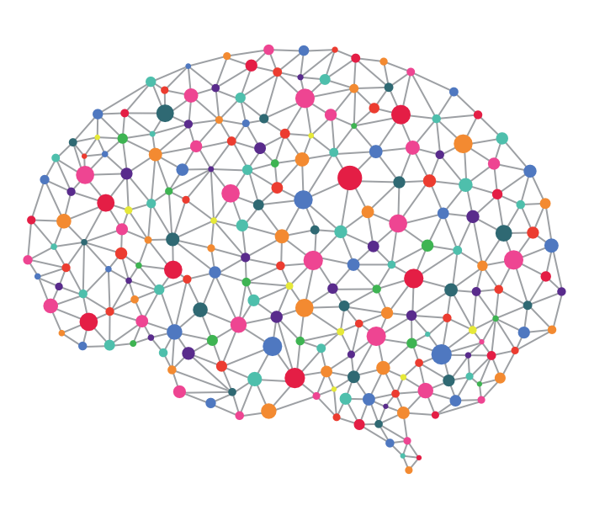
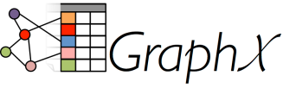
GraphChi
Graph
Datasets
GridGraph
Graph
Systems

Slide 3
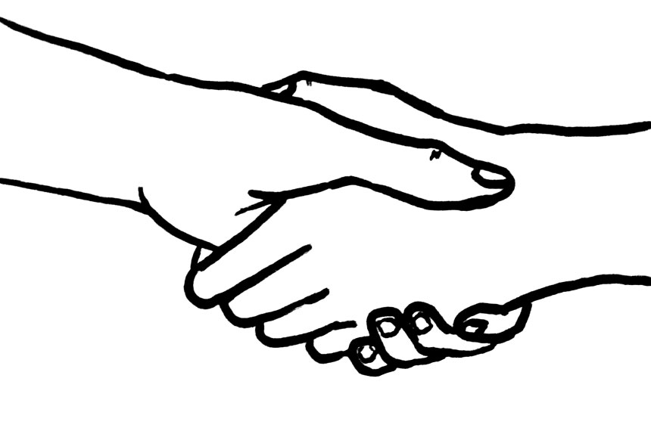
Intimacy Between Systems and App. Areas
Machine Learning
Information Retrieval
Bioinformatics
……
Systems

Slide 4
Where Is PL’s Position in Big Data? -- Another Source of Big Data
SAT Solver,
Program Analysis, Model Checking, …
PL
Problems
Existing Work
Big Data Systems
System
Solutions
Our Work
Scalable Results

Slide 5
Treating Static Analysis as Big Data Problem
An important PL problem: Context-sensitive static analysis of very large codebases
Pointer/alias analysis
Dataflow analysis
May/must analysis
…
Linux kernel
Large server applications
Distributed data-intensive systems
…

Slide 6
Context-Free Language (CFL) Reachability
A program graph P
A context-free Grammar G with balanced parentheses properties
K
l₁
l₂
a
b
c
c is K-reachable from a
K → l₁ l₂
Reps, Program analysis via graph reachability, IST, 1998

Slide 7
A Wide Range of Applications
Pointer/alias analysis
Dataflow analysis, pushdown systems, set-constraint problems can all be converted to context-free-language reachability problems
Alias
b = a;
c = b;
a
Assign
b
Assign
c
Alias → Assign⁺
Sridharan and Bodik, Refinement-based context-sensitive pointsto analysis for Java, PLDI, 2006
Zheng and Rugina, Demand-driven alias analysis for C, POPL, 2008

Slide 8
A Wide Range of Applications (Cont.)
Pointer/alias analysis
Address-of & / dereference* are the open/close parentheses
Alias
b = & a; // Address-of
c = b;
d = *c; // Dereference
a
&
b
Alias
c
*
d
Alias → Assign⁺
| & Alias *
Sridharan and Bodik, Refinement-based context-sensitive pointsto analysis for Java, PLDI, 2006
Zheng and Rugina, Demand-driven alias analysis for C, POPL, 2008

Slide 9
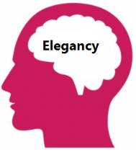
A Dynamic Transitive Closure Problem
Traditional Approach: a worklist-based algorithm
the worklist contains reachable vertices
no transitive edges are added physically
Problem: embarrassingly sequential and unscalable

Slide 10
No Worry About Memory Blowup
As long as one knows how to use disks and clusters
Big Data thinking:
Solution =
(1) Large Dataset + (2) Simple Computation +
System Design

Slide 11
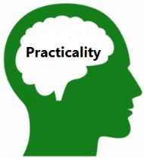
Turning Big Code Analysis into Big Data Analytics
Key insights:
Adding transitive edges explicitly – satisfying (1)
Core computation is adding edges – satisfying (2)
Leveraging disk support for memory blowup
Can existing graph systems be directly used?
No, none of them support dynamic addition of a lot of edges

Slide 12
Graspan: A Graph System for Interprocedural Static Analysis of Large Programs
Scalable
Disk-based processing on the developer's work machine
Parallel
Edge-pair centric computation
Easy to implement a static analysis
Developer only needs to generate graphs in mechanical ways and provide a context-free grammar to implement the analysis
4 students + 1 postdoc, 1.5 years of development; implemented in both Java and C++
https://github.com/Graspan/

Slide 13
How It Works?
G
GRAMMAR RULES

Slide 14
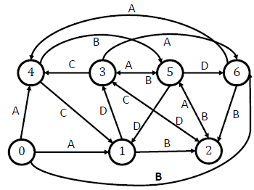
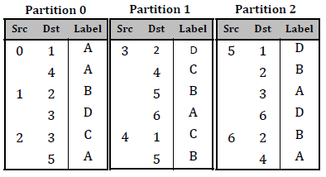
Granspan Design
Partitions are of similar sizes
Each partition contains an adjacency list of edges
Edges in each partition are sorted
Edge-Pair Centric
Computation
Preprocessing
Post-Processing

Slide 15
Computation Occurs in Supersteps
Edge-Pair Centric
Computation
Preprocessing
Post-Processing

Slide 16
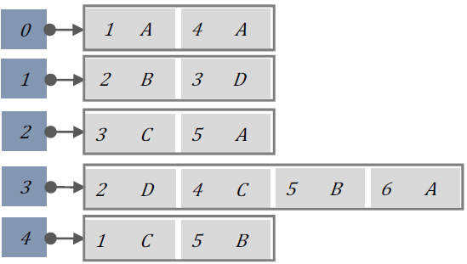
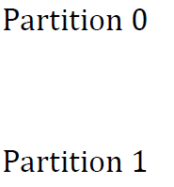
Each Superstep Loads Two Partitions
C
0
1
A
B
0
1
2
2
3
4
Edge-Pair Centric
Computation
Preprocessing
Post-Processing

Slide 17
Each Superstep Loads Two Partitions
0
1
2
3
4
We keep iterating until delta is 0
Edge-Pair Centric
Computation
Preprocessing
Post-Processing

Slide 18
Post-Processing
Repartition oversized partitions to maintain balanced load on memory
Save partitions to disk
Scheduler favors in-memory partitions and those with higher matching degrees
Edge-Pair Centric
Computation
Preprocessing
Post-Processing

Slide 19
What We Have Analyzed
Program | #LOC | #Inlines
Linux 4.4.0-rc5 | 16M | 31.7M
PostgreSQL 8.3.9 | 700K | 290K
Apache httpd 2.2.18 | 300K | 58K
With
A fully context-sensitive pointer/alias analysis
A fully context-sensitive dataflow analysis
On a Dell Desktop Computer with 8GB memory and 1TB SSD

Slide 20
Evaluation Questions and Answers
Can the interprocedural analyses improve D. Englers’ checkers?
Found 85 new bugs in Linux 4.4.0-rc5
Is Graspan efficient and scalable?
Computations took 11 mins – 12 hrs
How easy to use Graspan?
1K LOC of C++ for writing each of points-to and dataflow graph generators
Provide a grammar file
Graspan v/s other engines?
GraphChi crashed in 133 secs
LogicBlox and SocialLite ran out of memory for all our programs
Traditional analysis implementation ran 3 days for the smallest graph

Slide 21
Conclusion
4 students + 1 postdoc, 1.5 years of development;
Implemented in both Java and C++
https://github.com/Graspan/

