Slide 1
Facade: A Compiler and Runtime for (Almost) Object-Bounded Big Data Applications
Khanh Nguyen, Kai Wang, Yingyi Bu,
Lu Fang, Jianfei Hu, Harry Xu
UC Irvine
USA

Slide 2
BIG DATA

Slide 3
BIG DATA
Scalability
JVM crashes
due to OutOfMemory error at early stage
Management cost
GC time accounts for up to 50% of the execution time
[Bu et al. ISMM ’13]
High cost of the managed runtime is a fundamental problem!

Slide 4
Golden rule for scalability
The number of heap objects and references must not grow proportionally with the cardinality of the dataset
Facade
Non-intrusive technique
Operate at compiler level
General and practical
Require minimal user’s effort
Statically bound the number of data objects in the heap

Slide 5
Facade execution model
Data Representation
Data Manipulation
Use the off-heap, native memory to store unbounded data items
Create heap objects only for control purposes
Bounded object pooling
Many to One

Slide 6
Benefits from Facade
Significantly reduced GC time
Reduced memory consumption
Reduced memory access costs
Reduced execution time
Improved scalability

Slide 7
Static bound of data objects
O(s)
O(t*n+p)
t : number of threads
s : cardinality of the data set
n : number of data types
p : number of pages
Org.
14,257,280,923
(GraphChi OSDI ‘12)
1,363
Facade

Slide 8
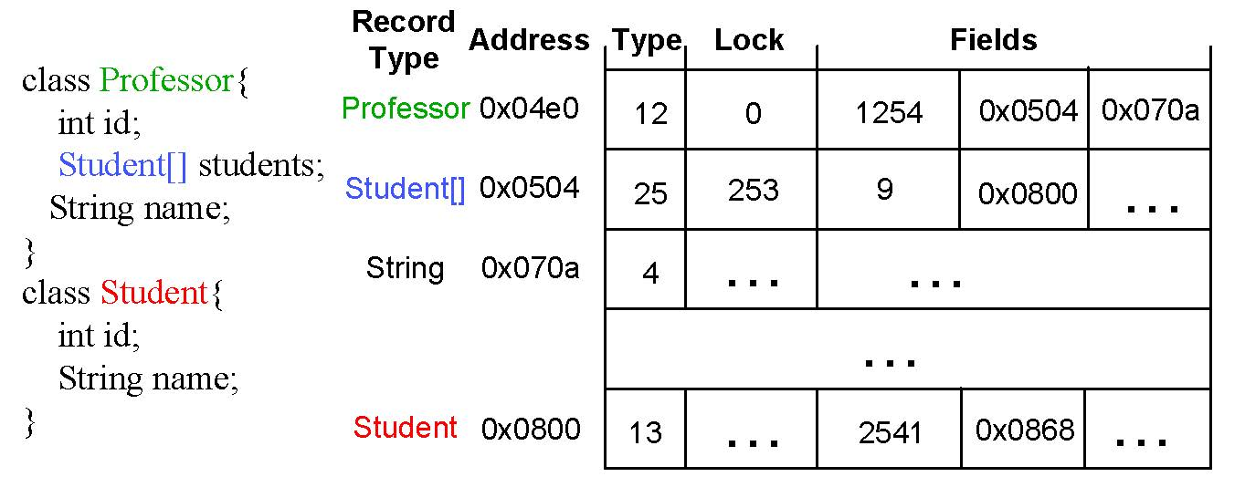
Data representation
Native memory
id
name
students
Memory address is used as object reference (pointer)= pageRef

Slide 9
Data manipulation
D
automatic
DF
user-specified data class
Facade class
Object references are substituted by pageRef
Objects are created as facades for control purposes
Professor p = f;
long pRef = fRef;

Slide 10
p.addStudent(s);
Have only pRef and sRef
ProfessorFacade pf = professorPool[0];
StudentFacade sf = studentPool[0];
pf.pageRef = pRef;
sf.pageRef = sRef;
pf.addStudent(sf);
void addStudent(StudentFacade sf) {
long thisRef = this.pageRef;
long sRef = sf.pageRef;
//...
}

Slide 11
Orig.
p.addStudents (s1,s2,s3,s4,s5)
Facade
pf.addStudents (sf1,sf2,sf3,sf4,sf5)
pf = professorPool[0];
sf1 = studentPool[0];
sf2 = studentPool[1];
sf3 = studentPool[2];
sf4 = studentPool[3];
sf5 = studentPool[4];
statically created; bounded by the max # operands of type Professor/
Student

Slide 12
Challenge 1
Dynamic dispatch
Use type ID in the record’s header
Parameter facade pool
Separated receiver facade pool
p.addStudent(s);
ProfessorFacade pf = FacadeRuntime.resolve(pRef);

Slide 13
Challenge 2
Concurrency:
Thread-local facade pooling
Global lock pool to support object locks
Object locks
Get a free lock l from the lock pool;
Write l into the lock field of oRef
l.compareAndInc();
enterMonitor(l);
…
exitMonitor(l);
if(l.compareAndDec()
== 0){
Write 0 into the lock field of oRef
return l to the pool;}
enterMonitor(o);
…
exitMonitor(o);

Slide 14
Memory management
Allocation
High-performance parallel allocator
Thread-local managers
Uses different size classes
Insights:
Data-processing functions are iteration-based
Each iteration processes distinct data partition
Data objects in each iteration have disjoint lifetime
Deallocation
Use a user-provided pair of calls to recycle pages:
iteration_start() && iteration_end()
Iterations are well-defined --- it took us only a few minutes to find iterations and insert callbacks in GraphChi

Slide 15
Other supports
Optimizations:
Object inlining for records whose size is known statically
Oversized pages for large arrays
Type specialization
…
Support most of Java 7 features
Details can be found in the paper

Slide 16
Experiments
3 frameworks, 7 applications
GraphChi [Kyrola et al. OSDI’12]
High-performance graph analytical framework for a single machine
Hyracks [Borkar et al. ICDE’11]
Data parallel platform to run data-intensive jobs on a cluster of shared-nothing machines
GPS [Salihoglu and Widom SSDBM’13]
Distributed graph processing system for large graphs

Slide 17
GraphChi
36.7% improv.
6.4x reduction
Page Rank
5.8% improv.
4x reduction
Connected Component

Slide 18
GraphChi - Throughput
X 10⁵
1.4x improvement
Facade

Slide 19
Hyracks
31x reduction in GC time
External Sort
32% reduction in mem. consumption
Word Count
The original program crashed in all of these sets thus no figure

Slide 20
GPS
Page Rank, KMeans & Random Walk
Reduction in largest graph: 120M vertices, 1.7B edges

Slide 21
GPS
Page Rank, KMeans & Random Walk
Average cumulative reduction

Slide 22
Results
GraphChi (Page Rank & Connected Components)
Up to 6.4x reduction in GC time
Up to 28% reduction in memory usage (6+GB datasets)
Up to 48% reduction in execution time
1.4x improvement in throughput
Hyracks (Word Count & External Sort)
3.8x improvement in scalability
Up to 88x reduction in GC time
Up to 32% reduction in memory usage
Up to 10% reduction in execution time
GPS (Page Rank, KMeans & Random Walk)
Up to 40% reduction in GC time
Up to 15% reduction in execution time
Max reduction
GC time: 88x
Execution time: 48%
Memory usage: 32%

Slide 23
Conclusion
Facade is a complete package:
Compiler: automatically transform existing programs
Runtime system: run on top of JVM, i.e., no modification of JVM
Thank you!

